Slide 1
Face Detection and Recognition

Slide 2
Group members:
Tanveer Ahmed
Tania Akter
Nahida Khan
Roni

Slide 3
Overview:
History of face detection
Difference between face detection and face recognition
Discuss the algorithm and concrete computation for face detection
Discuss the algorithm and concrete computation for face recognition
Explain the methodology

Slide 4
History of face detection
Face recognition began as early as 1977
In 1983 principal component analysis(PCA) was introduced for feature extraction.
Eigenface was developed in 1991
Local binary pattern analysis for texture recognition was introduced in 1994 , later it incorporating with Histograms(LBPH)
Viola and Jones introduced a face detection technique using HAAR cascades and ADABoost

Slide 5
Difference between face detection and face recognition
Face detection refers to computer technology that is able to identify the presence of people’s faces within digital images. Face detection is a broader term than face recognition.
Face recognition describes a biometric technology that goes way beyond recognizing when a human face is present. It actually attempts to establish whose face it is.

Slide 6
Viola–Jones algorithm explain
The algorithm has four stages:
Haar Feature Selection
Creating an Integral Image
Adaboost Training
Cascading Classifiers

Slide 7
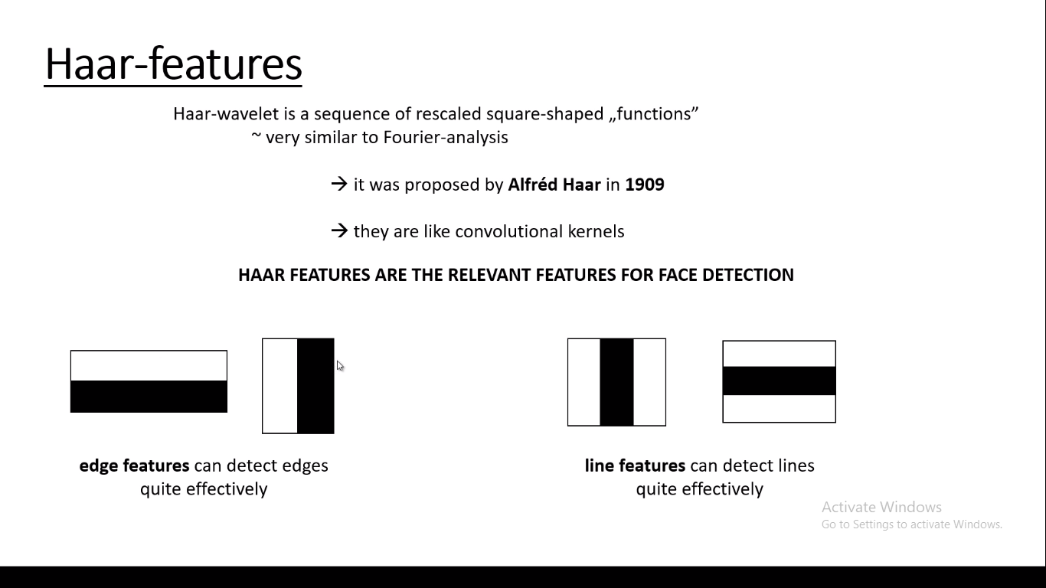

Slide 8


Slide 9
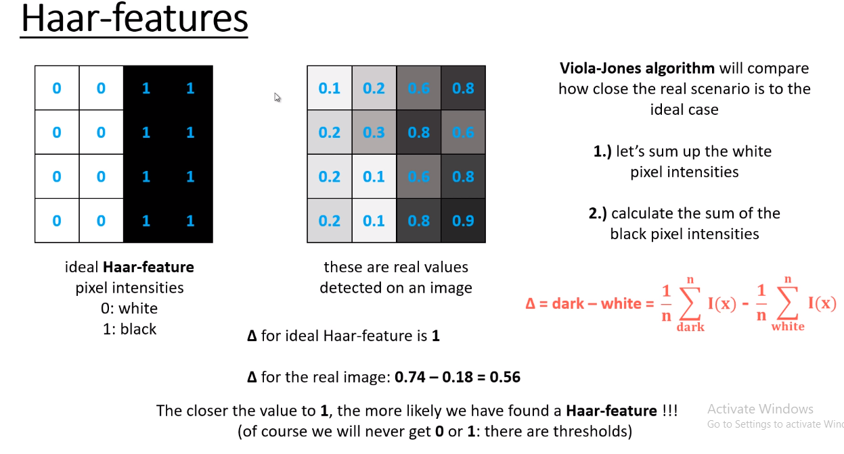

Slide 10
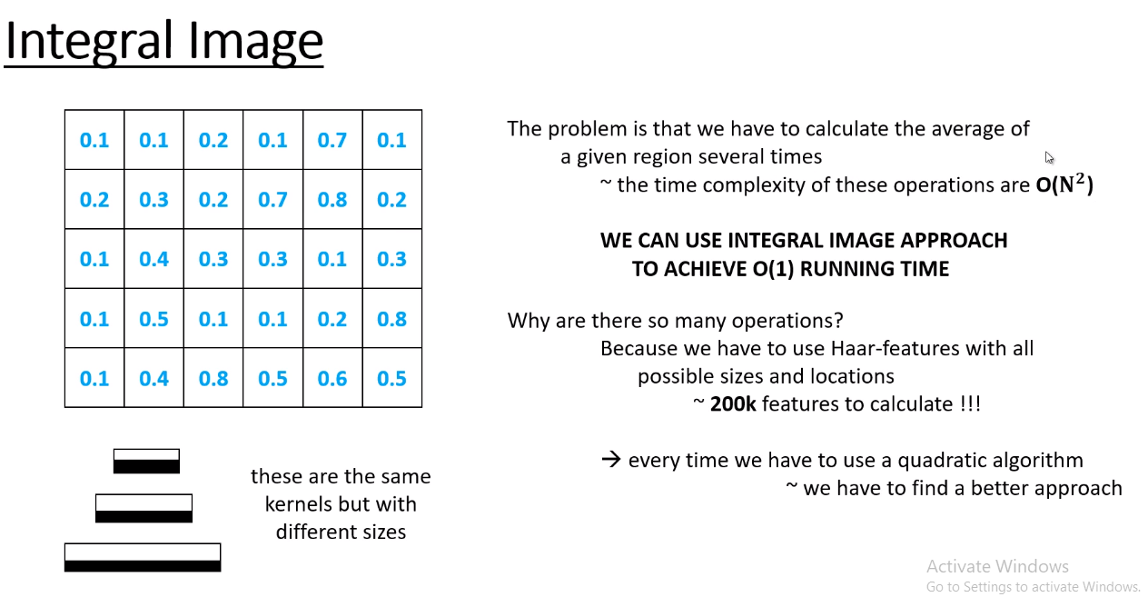

Slide 11
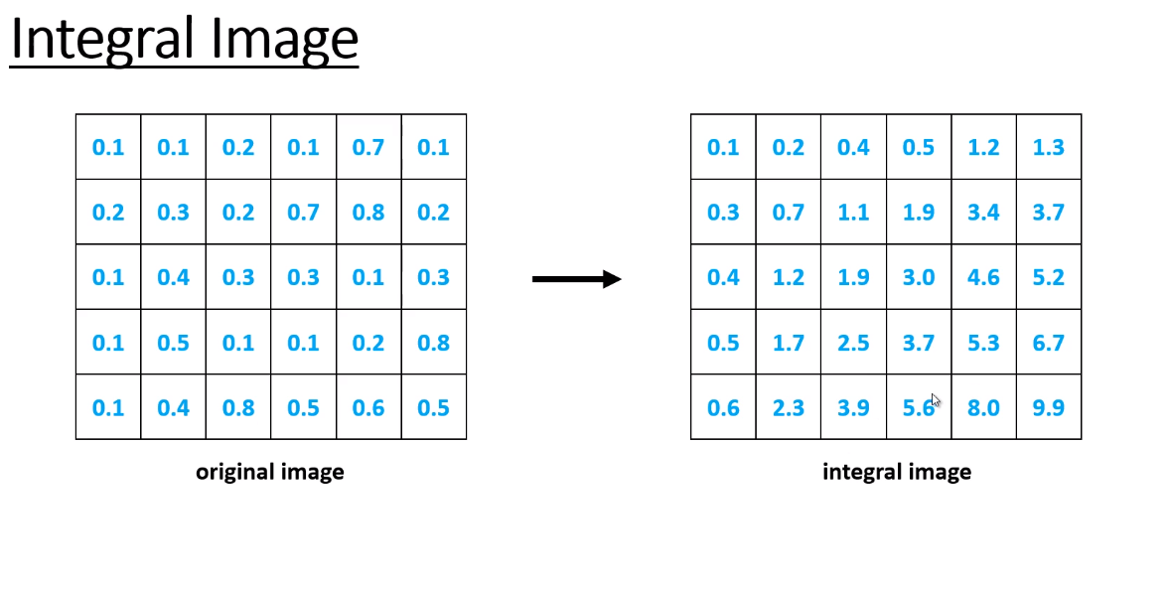

Slide 12
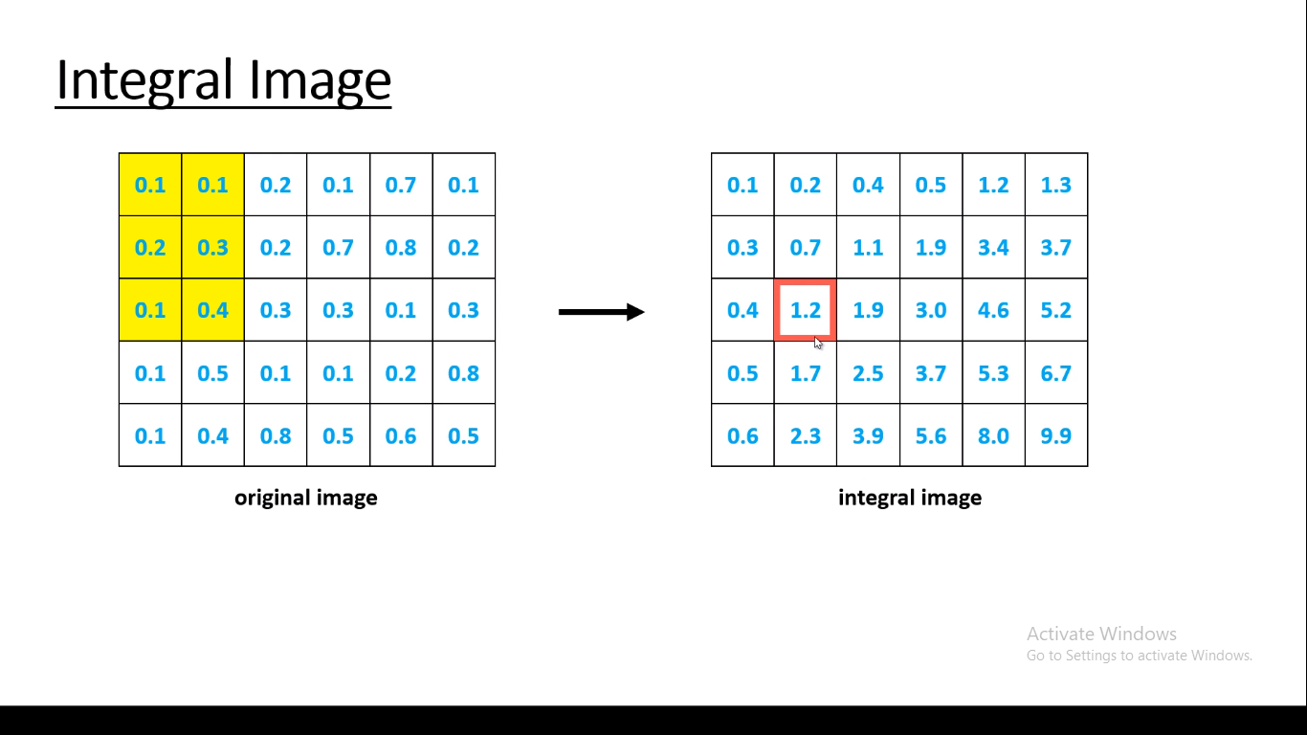
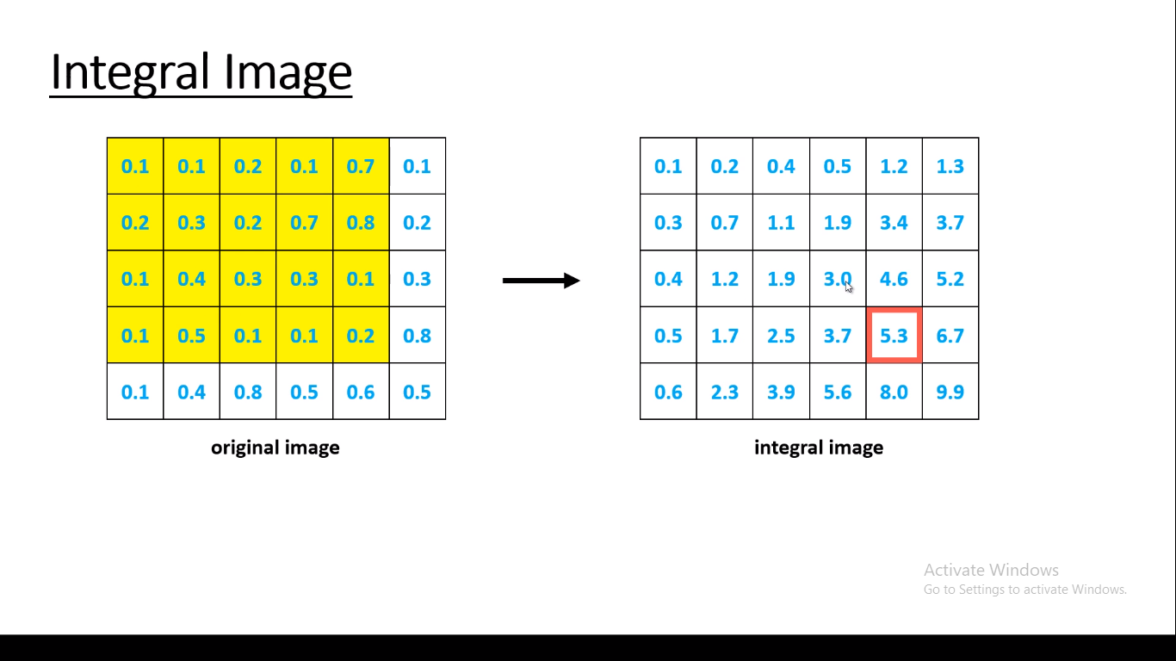

Slide 13
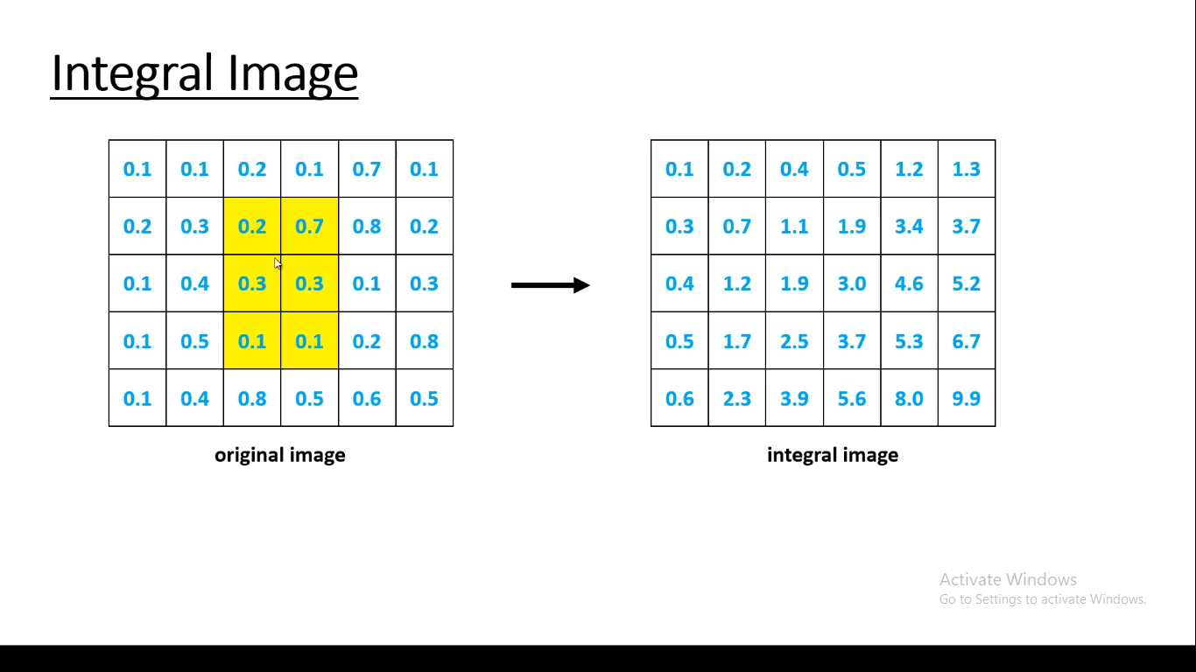
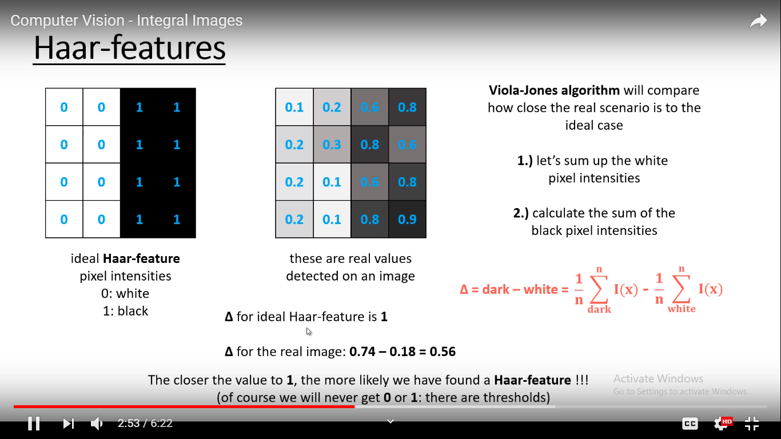

Slide 14
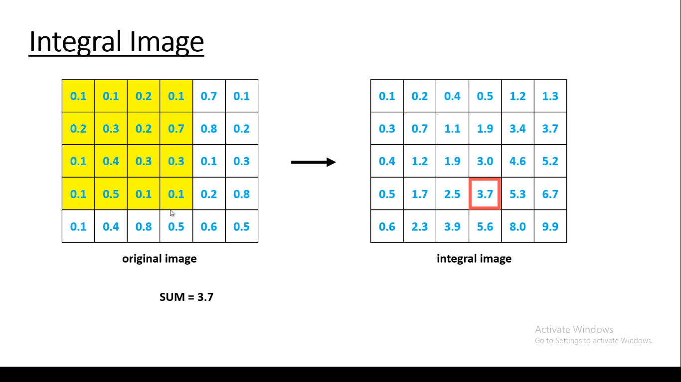
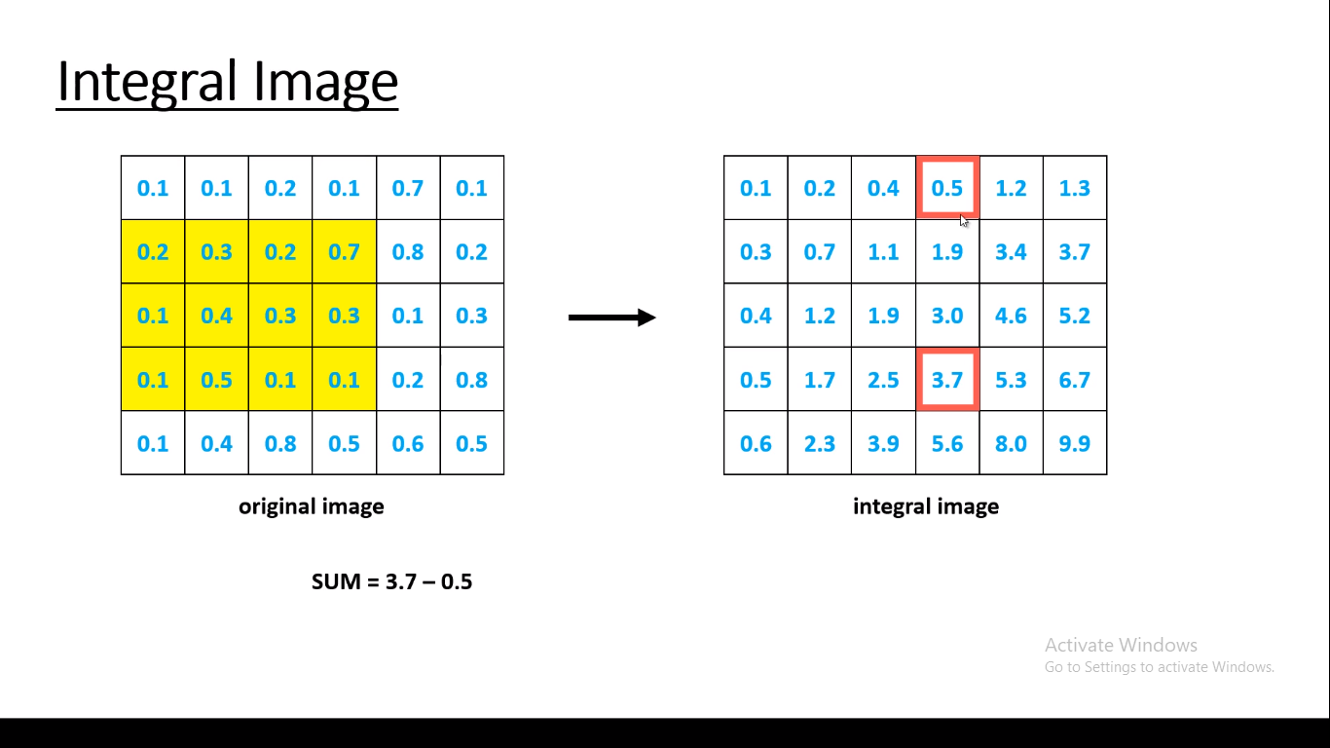
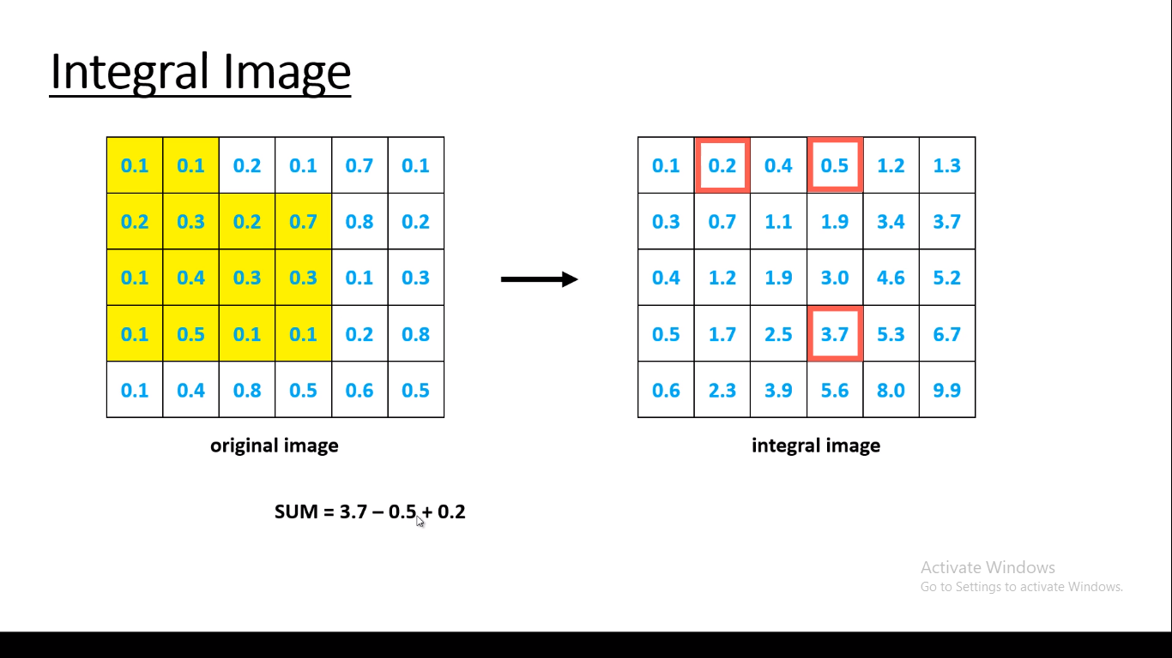
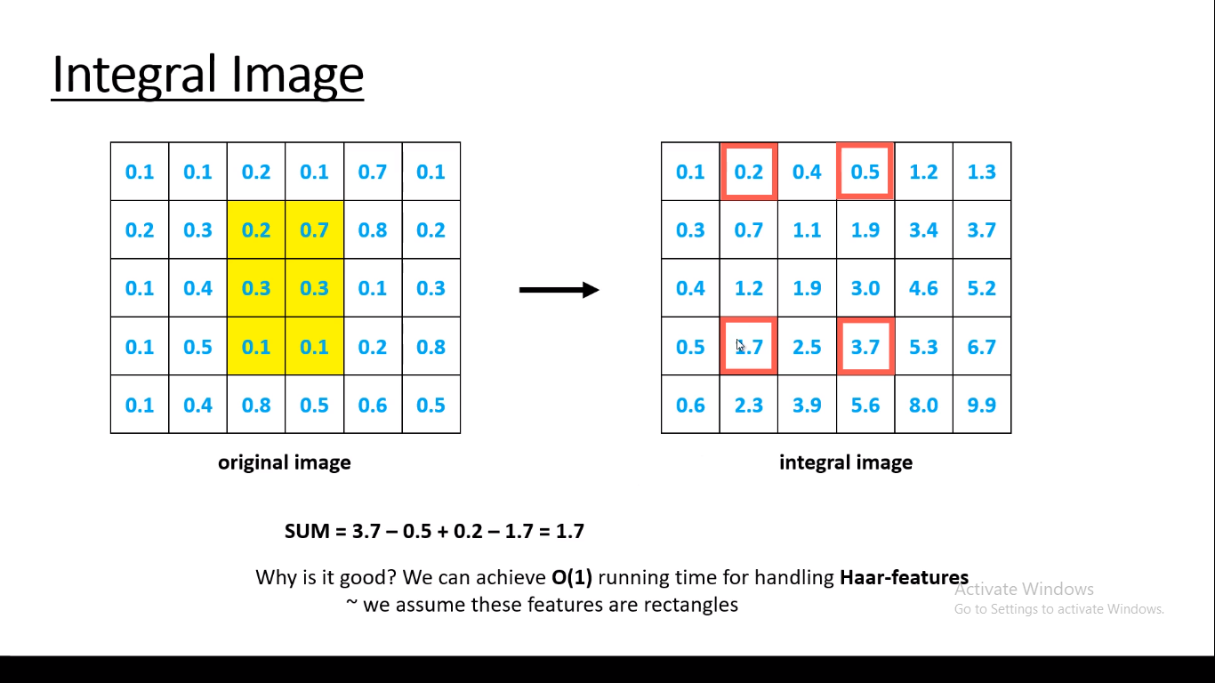

Slide 15
Cascading Classifiers
For this they introduced the concept of Cascade of Classifiers. Instead of applying all the 6000 features on a window, group the features into different stages of classifiers and apply one-by-one. (Normally first few stages will contain very less number of features). If a window fails the first stage, discard it. We don’t consider remaining features on it. If it passes, apply the second stage of features and continue the process. The window which passes all stages is a face region. How is the plan !!!
Authors’ detector had 6000+ features with 38 stages with 1, 10, 25, 25 and 50 features in first five stages. (Two features in the above image is actually obtained as the best two features from Adaboost). According to authors, on an average, 10 features out of 6000+ are evaluated per sub-window.

Slide 16
Face Recognition Algorithm LBPH Explain
Local Binary Pattern Histogram (LBPH) is a simple yet very efficient texture operator which labels the pixels of an image by thresholding the neighborhood of each pixel and considers the result as a binary number.
it improves the detection performance considerably on some datasets. we will discuss it into 4 steps
1. Parameters: The LBPH uses 4 parameters:
Radius
Neighbors
Grid X
Grid Y

Slide 17
2. Training the Algorithm: First, we need to train the algorithm.
we need to use a dataset with the facial images of the people we want to recognize.
We need to also set an ID (it may be a number or the name of the person) for each image. Images of the same person must have the same ID. With the training set already constructed, let’s see the LBPH computational steps.
3. Applying the LBP operation: It creates an intermediate image that describes the original image in a better way, by highlighting the facial characteristics. To do so, the algorithm uses a concept of a sliding window, based on the parameters radius and neighbors.
The image below shows this procedure:

Slide 18
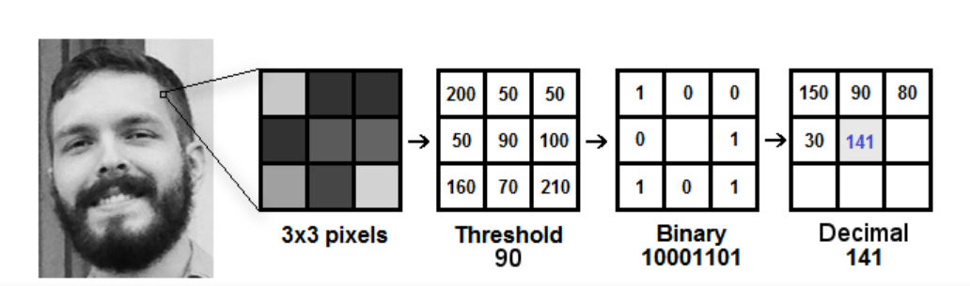
Suppose we have a facial image in grayscale.
take the central value of the matrix to be used as the threshold.
This value will be used to define the new values from the 8 neighbors.
each neighbor is compared with the center pixel.
We set 1 for values equal or higher than the threshold and 0 for values lower than the threshold.
Now, the matrix will contain only binary values (ignoring the central value).
concatenate each binary value to get new binary value (e.g. 10001101). Then, we convert this binary value to a decimal value and set it to the central value of the matrix, which is actually a pixel from the original image.
At the end of this procedure (LBP procedure), we have a new image which represents better the characteristics of the original image.

Slide 19
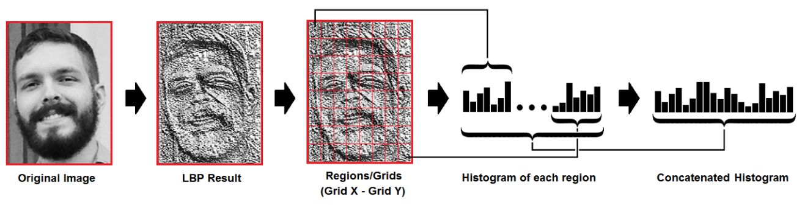
4. Extracting the Histograms: Now, using the image generated in the last step, we can use the Grid X and Grid Y parameters to divide the image into multiple grids, as can be seen in the following image.
Based on the image above, we can extract the histogram of each region as follows:
As we have an image in grayscale, each histogram (from each grid) will contain only 256 positions (0~255) representing the occurrences of each pixel intensity.
Then, we need to concatenate each histogram to create a new and bigger histogram. Supposing we have 8x8 grids, we will have 8x8x256=16,384 positions in the final histogram. The final histogram represents the characteristics of the original image.

Slide 20
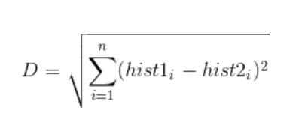
5. Performing the face recognition: In this step, the algorithm is already trained. Each histogram created is used to represent each image from the training dataset. So, given an input image, we perform the steps again for this new image and creates a histogram which represents the image.
So to find the image that matches the input image we just need to compare two histograms and return the image with the closest histogram.
We can use various approaches to compare the histograms (calculate the distance between two histograms), for example: Euclidean distance, chi-square, absolute value, etc. In this example, we can use the Euclidean distance (which is quite known) based on the following formula:

Slide 21
Methodology
We have done this project in 3 stages
Stage1: Store data
Stage2: Train the classifier
Stage3: Compare stored data with input data for recognition

Slide 22
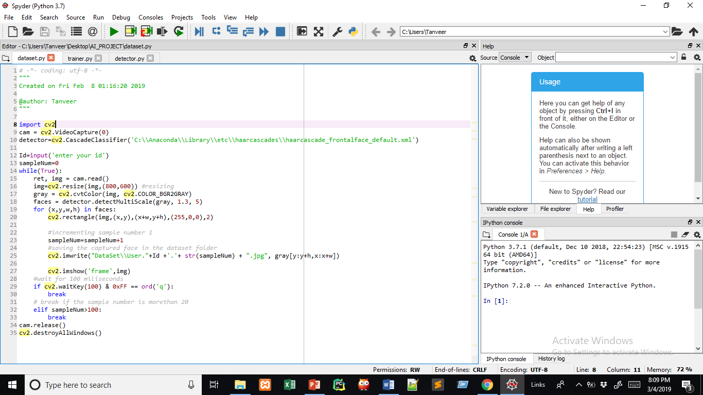
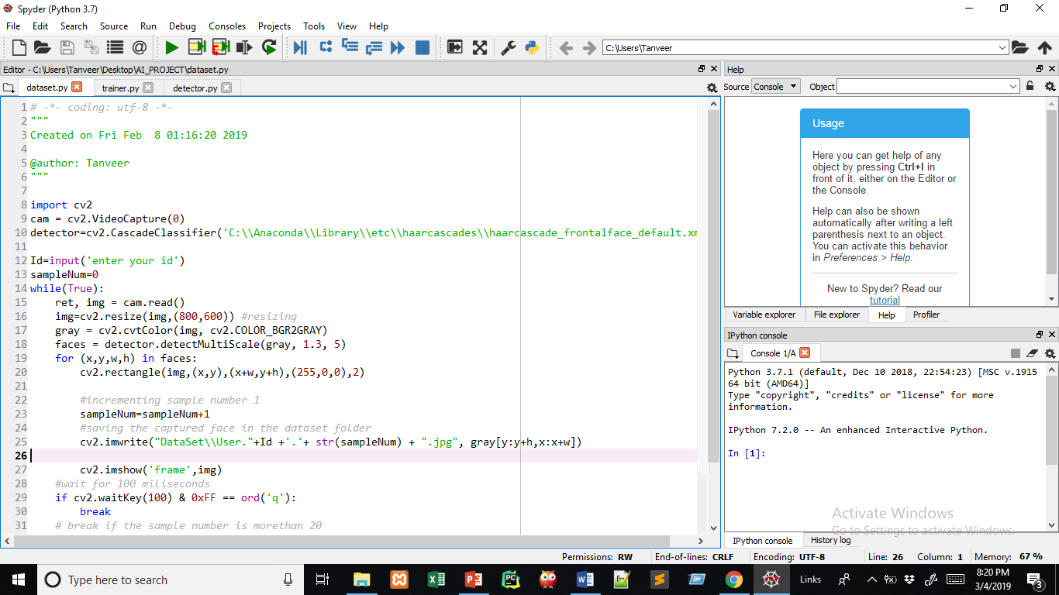
Stage 1: Store the data
Here we create an object of casecadeClassifier then load the respective XML file, which was predefined ,it was trained for face detecting.
Then we have to enter an id number,after that A camera object is created using the cv2.VideoCapture() to capture images.
By using the CascadeClassifier.detectMultiScale() object of various sizes are matched and location is returned. Using the location data, the face is cropped for further verification

Slide 23
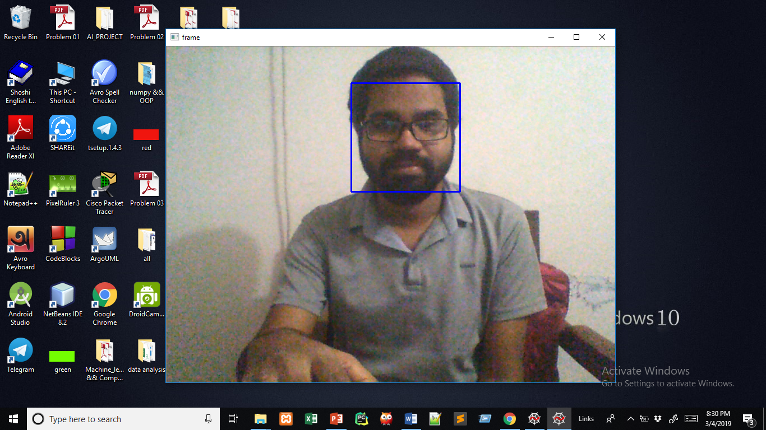
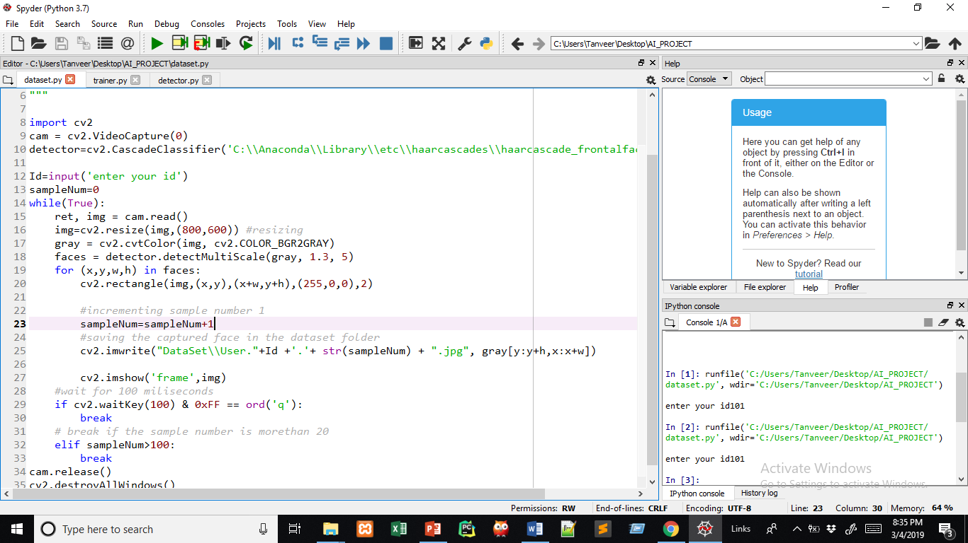
Here we find a face and draw a blue rectangle over it
<- (Method to draw a rectangle)

Slide 24

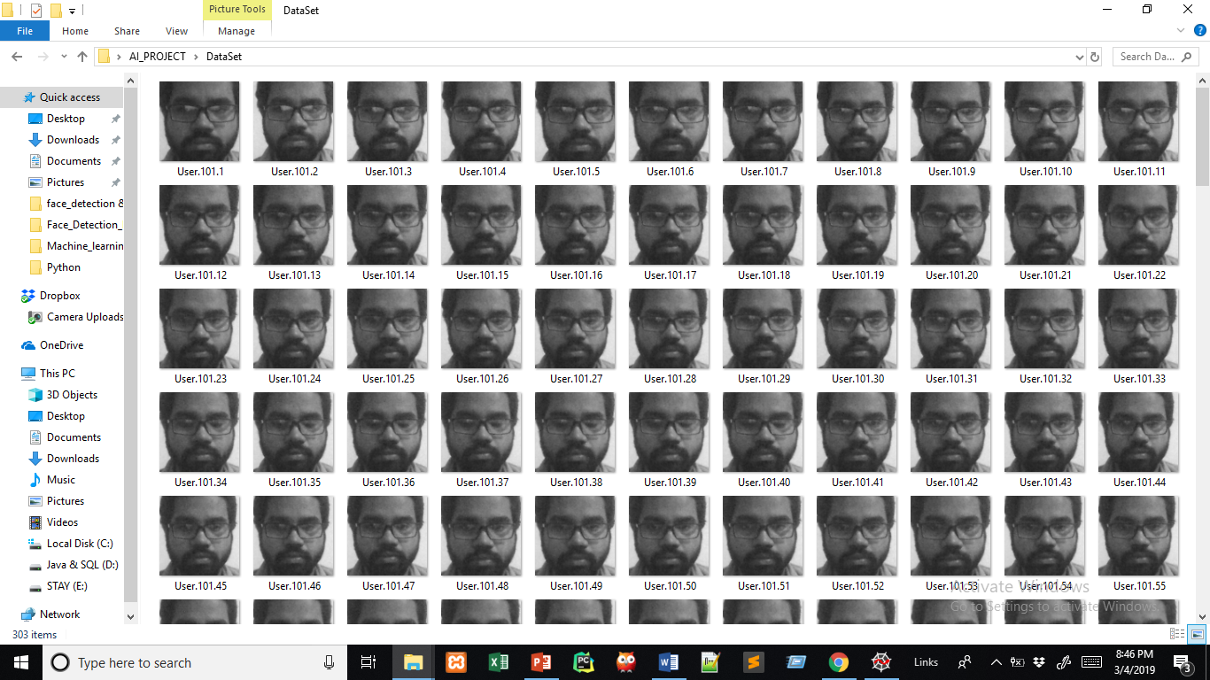
Now we crop that image with the size of that rectangle and store it into dataset directory
<-(Method to save image into dataset directory)
This is our dataset directory 101 images will be stored here for single ID

Slide 25
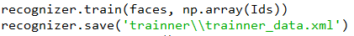
Stage 2: Training the Classifier
OpenCV enables the creation of XML files to store features extracted from datasets using the FaceRe-cognizer class. The stored images are imported, converted to grayscale and saved with IDs in two lists with same indexes. FaceRecognizer objects are created using face recogniser class. Each recogniser can take in parameters that are described below:
By using FaceRecognizer.train(NumpyImage, ID) method the object will be trained.Next, the configuration model is saved as a XML file using FaceRecognizer.save(FileName).
<-(Methods for train and save the data)

Slide 26
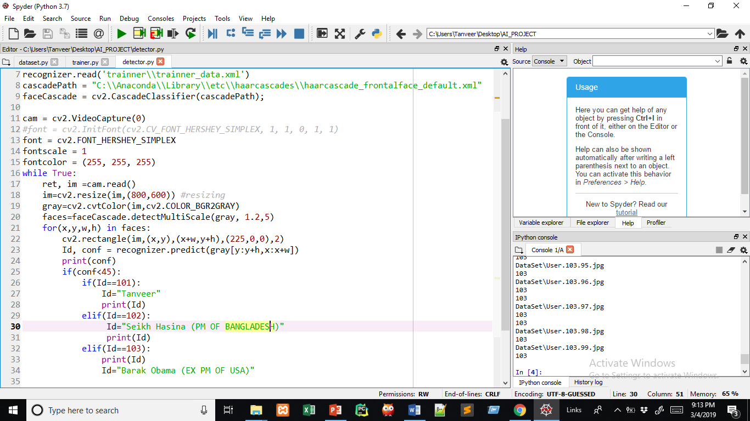
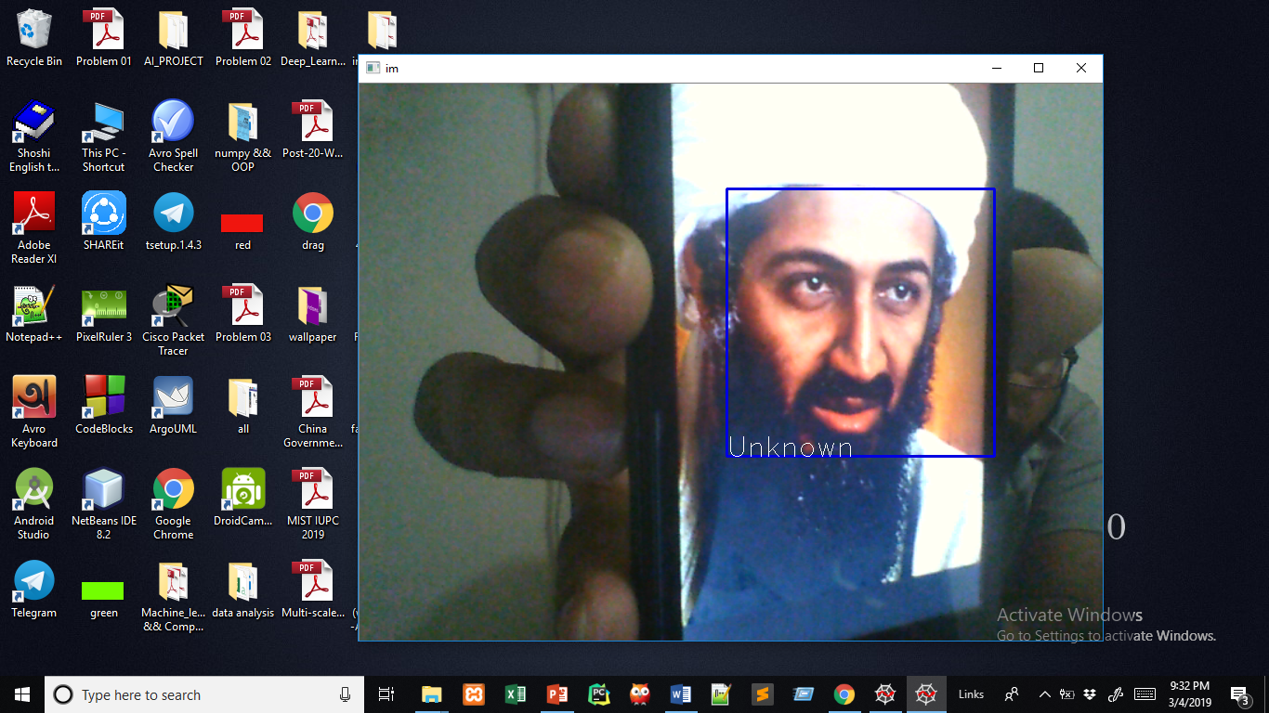
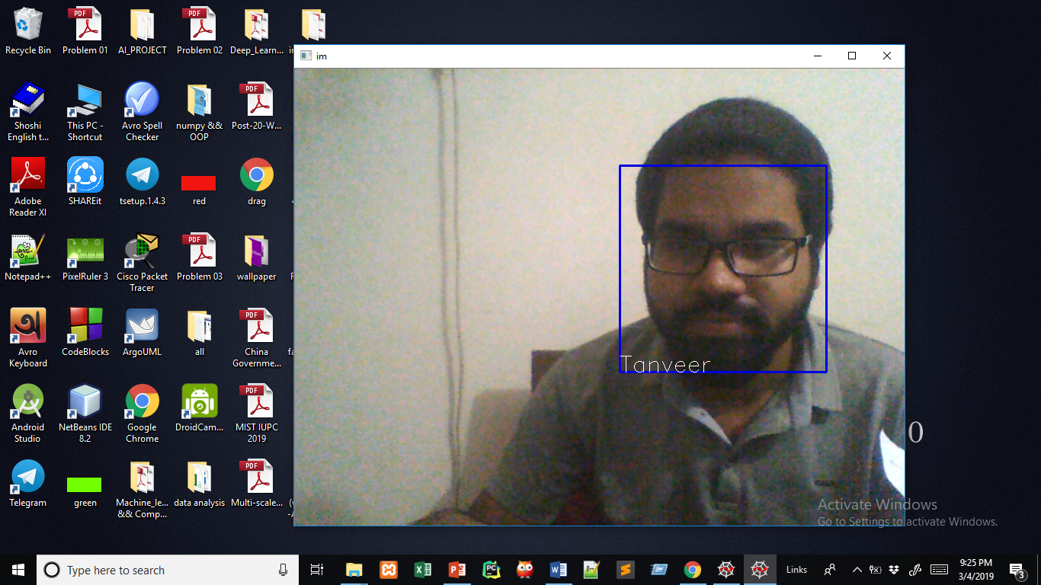
Stage 3: recognizing the face
To find the image that matches the input image we just need to compare two histograms and return the image with the closest histogram.
( This method predict the similarities between input data and stored data )
Result:
Match with dataset
Did not match with dataset

Slide 27
Thank you

